Slide 1
Hadoop platform: Visualizing Website clickstream data
Lab 2

Slide 2
Training Outcome
After completing this training, the participant should be able to:
Understand and apply the core tools used to process and analyze big data.
Identify the components of a Hadoop platform and application framework
Be familiar with Hadoop platform such as hortonwork.
Hands on walk through example with hadoop platform (e.g hortonwork)
Take practical steps to begin a success big data initiative

Slide 3
Training Outline
Hadoop Component such as Pig, hive and Catalog
Hand on exploration of the Hortonworks VM

Slide 4
Step 1 – BIOS Configuration
Before starting the tutorial, the BIOS settings must be configured in the computer / laptop used.
Restart the computer and immediately press F2.
Navigate to the security settings and select the Intel Virtualization Technology (Intel VT) and enabled it.
Navigate to the save & exit menu and save the settings.
Note:
Different key might need to be used for different windows to enable the BIOS settings such as F10 or F12. Press the key based on the computer preferences.
If the Intel VT setting has been enabled, disable and enable it once again.

Slide 5
Step 2 - Requirements
The software used in tutorial must be prepared.
Oracle VM Virtual Box 5.0.20 (Windows)
Hortonworks Sandbox 2.1
Hortonworks ODBC driver (Windows)
Microsoft Excel 2013 Professional
Microsoft Silverlight
Download RefineDemoData.zip that are going to be used in the tutorial and extract it.
Note:
Hortonworks Sandbox version 2.1 must be installed according to the computer system either 32-bit or 64-bit
If installation of Oracle VM Virtual Box 5.0.20 failed, download the latest version of the software at https://www.virtualbox.org/wiki/Downloads
RefineDemoData.zip can be downloaded at http://hortonworks.com/hadoop-tutorial/how-to-visualize-website-clickstream-data/#section_2
Download Microsoft Silverlight at https://www.microsoft.com/getsilverlight/Get-Started/Install/Default.aspx

Slide 6
Step 3 – Install and Configure Hortonworks ODBC Driver
Install the Hortonworks ODBC Driver.
Open Administrative Tools (Control Panel). Double-click Data Sources (ODBC) and click System DSN.
Select Sample Hortonworks Hive DSN and click Configure.
The setting is configured by changing the Host(s) to 127.0.0.1.
The User Name is changed to hue.
Check either the configuration is successful or not, by clicking on Test button.
Note:
The ODBC Driver can be downloaded at http://hortonworks.com/downloads/#data-platform

Slide 7
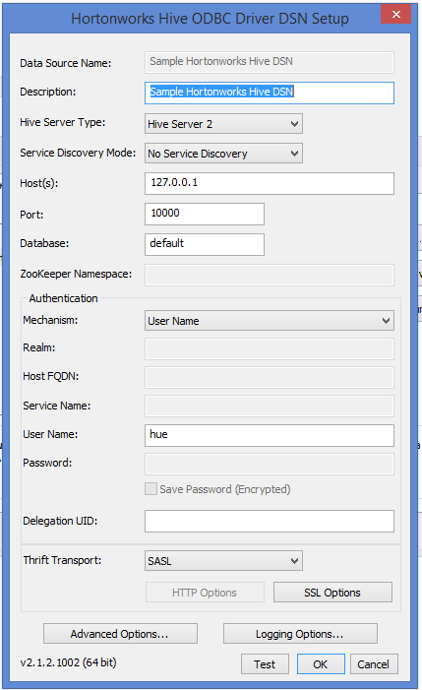
Figure 1: ODBC Driver DSN Setup

Slide 8
Step 4: Install Microsoft Silverlight
If the computer used does not have Microsoft Silverlight, install Microsoft Silverlight.
Silverlight is important to be installed to enable us to use Power View to analyze the data (Step 13)

Slide 9
Step 5 – Install VM Virtual Box and Hortonworks Sandbox
Install Oracle VM Virtual Box. Open the application once installation has finished.
On the File menu, click Import Appliance.
Click on the upload icon in Import Virtual Appliance window.
Locate the Hortonworks Sandbox 2.1 application and select it.
Click Import and wait until the Import progress reaches 100%.

Slide 10
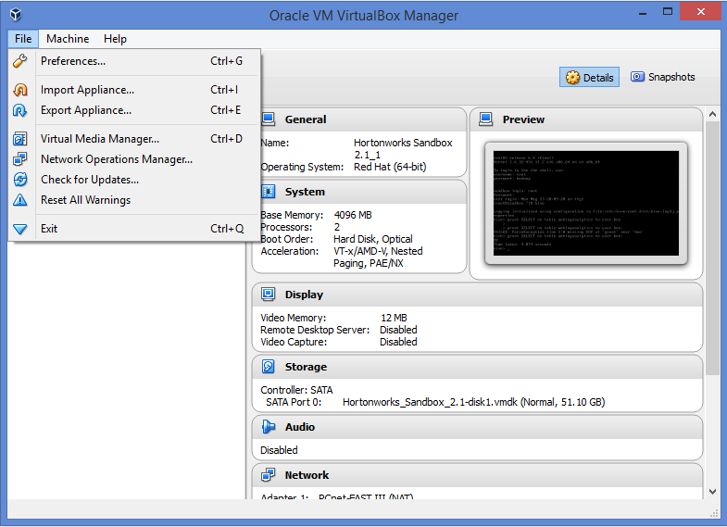
Figure 2: Import Appliance

Slide 11
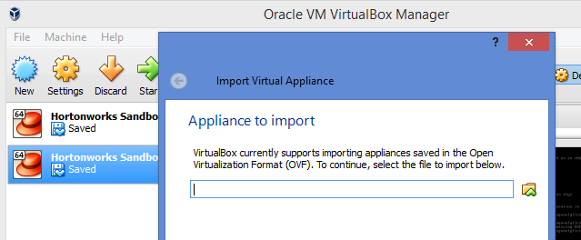
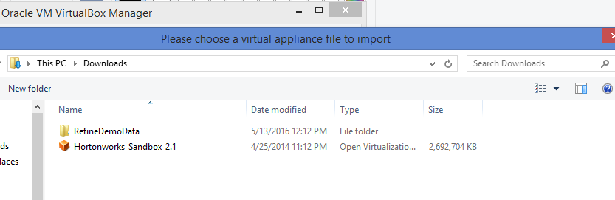
Figure 3: Upload Hortonworks Sandbox

Slide 12
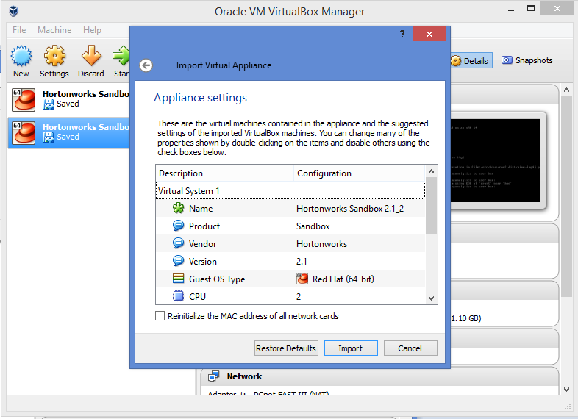
Figure 4: Confirm Import

Slide 13
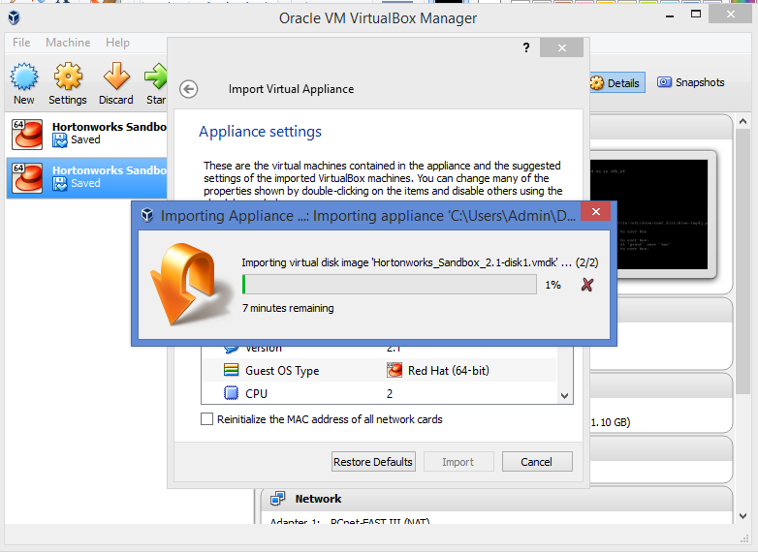
Figure 5: Import Progress

Slide 14
Step 6 – Start Up and Set Up Hortonworks
Another pop-up window appears once the Hortonworks has finished been imported.
The Hortonworks application is starting and setting up the settings.
Wait until Hortonworks finished preparing everything.

Slide 15
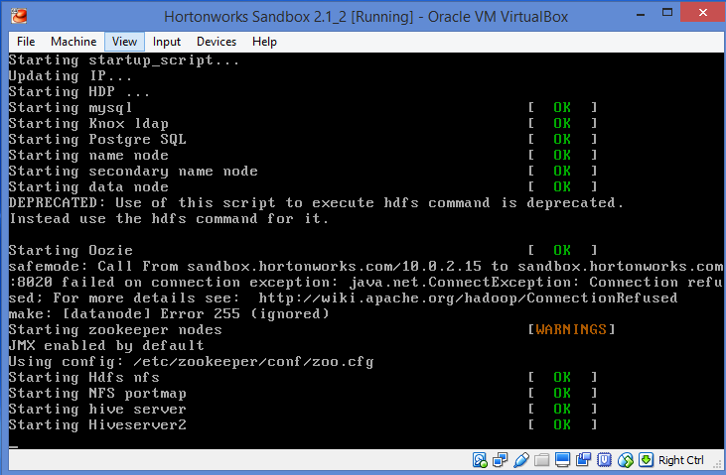
Figure 6: Hortonworks Start and Set Up Settings

Slide 16
Step 7: Open Hortonworks in Browser
Open web browser (Mozilla/Chrome).
Type http://127.0.0.1:8888 in the address bar and press Enter (Figure 7).
Register in the registration form as per required.
Tick the checkbox on the I agree to Terms of Use.
Click Submit
Note:
Just fill anything (not necessarily real information) in the registration form

Slide 17
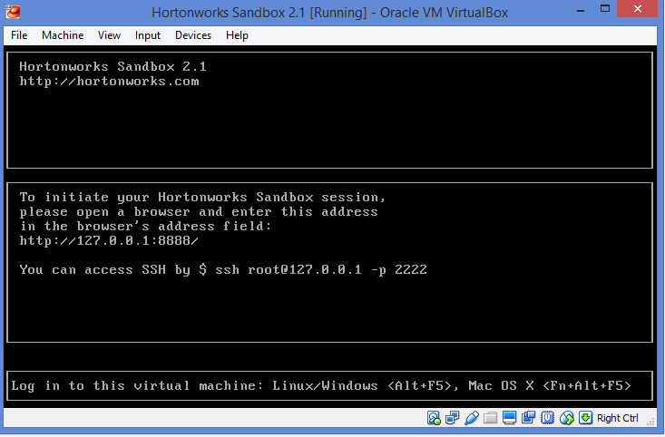
Figure 7: Finished set up Hortonworks

Slide 18
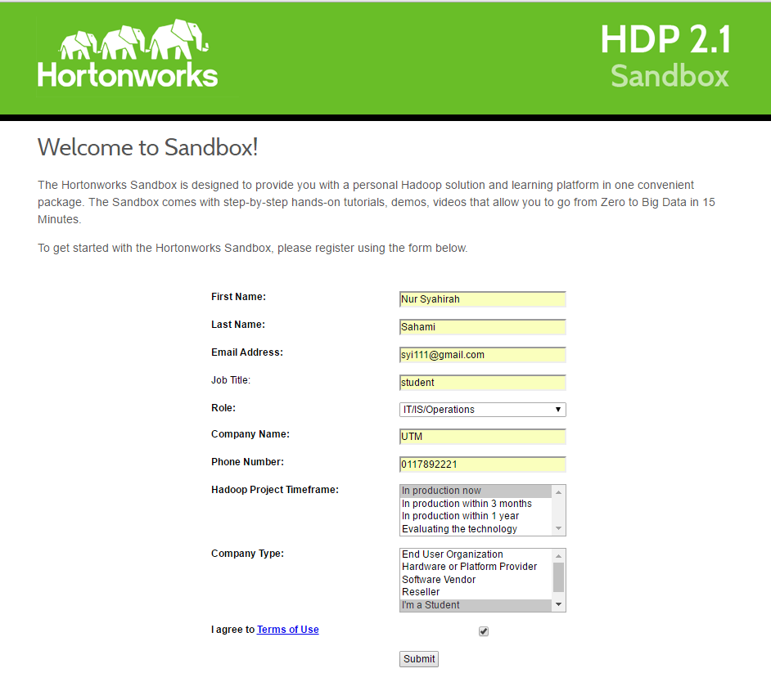
Figure 8 : Registration Form

Slide 19
Step 8: Create omniturelogs Table
Look at the Dive right in section and click the url http://127.0.0.1:8000
The browser navigates to another page.
Select Enable Ambari
The browser will navigate to Hcat (Hcatalog) page. On the left side, click create a new table from file to create new table.
Name the table as omniturelogs.
On Input File, click Choose a file.

Slide 20
On Choose a file, click Upload a file.
On the extracted RefineDemoData.zip, select Omniture.0.tsv.gz.
Click Open.
Then, click the uploaded Omniture.0.tsv.gz.
On File Options, untick read column header.
Scroll down and click create table.
On the top of left side, a progress indicator on creating the table can be seen.
Once finished, the data in omniturelogs table can be seen by clicking browse data in the list of tables.
Note:
Read column header is used to read the first column as the column name

Slide 21
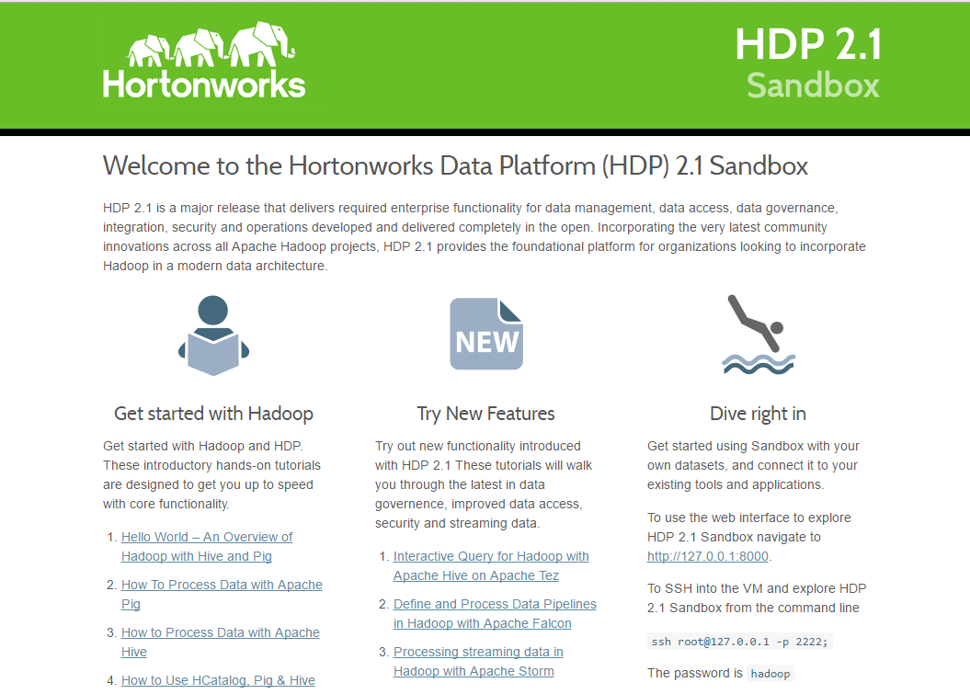
Figure 9: Dive right in

Slide 22
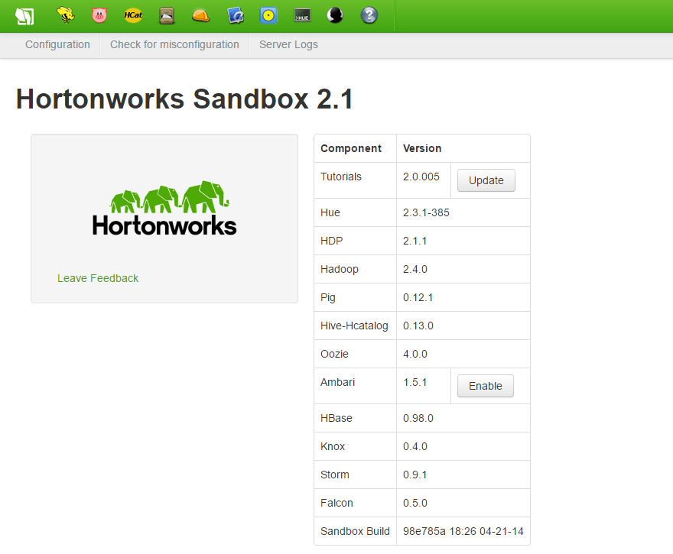
Figure 10: Enable Ambari

Slide 23
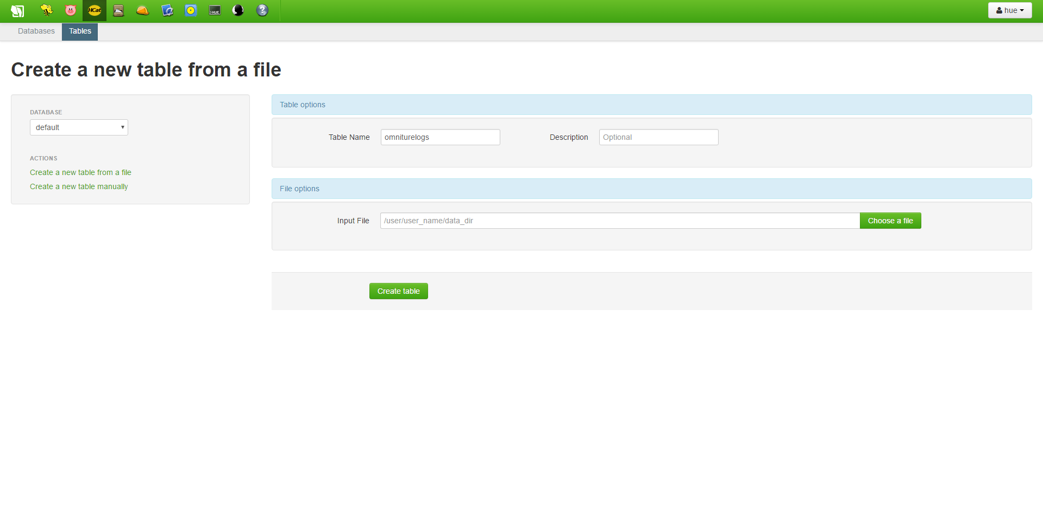
Figure 11: Create omniturelogs table

Slide 24
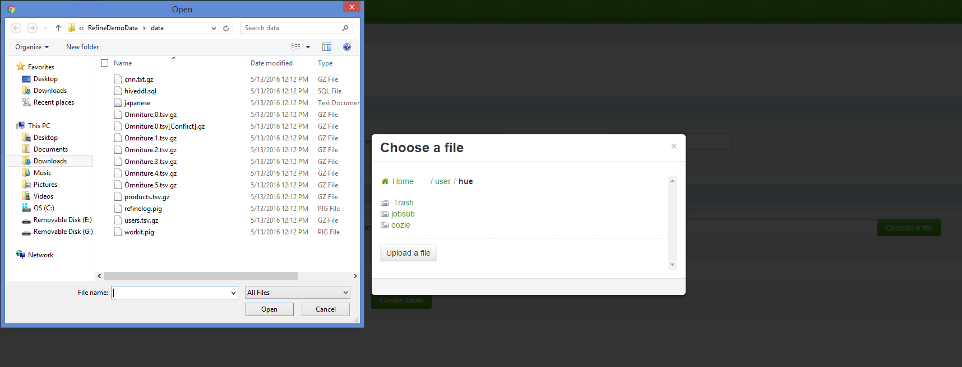
Figure 12: Upload Omniture.0.tsv.gz

Slide 25
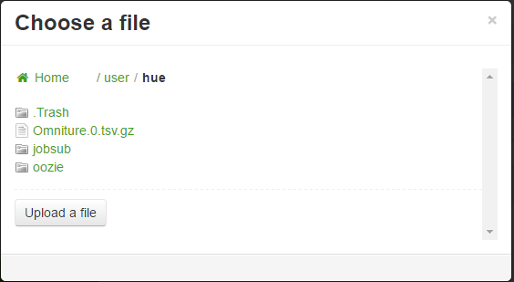
Figure 13: Uploaded Omniture.0.tsv.gz

Slide 26
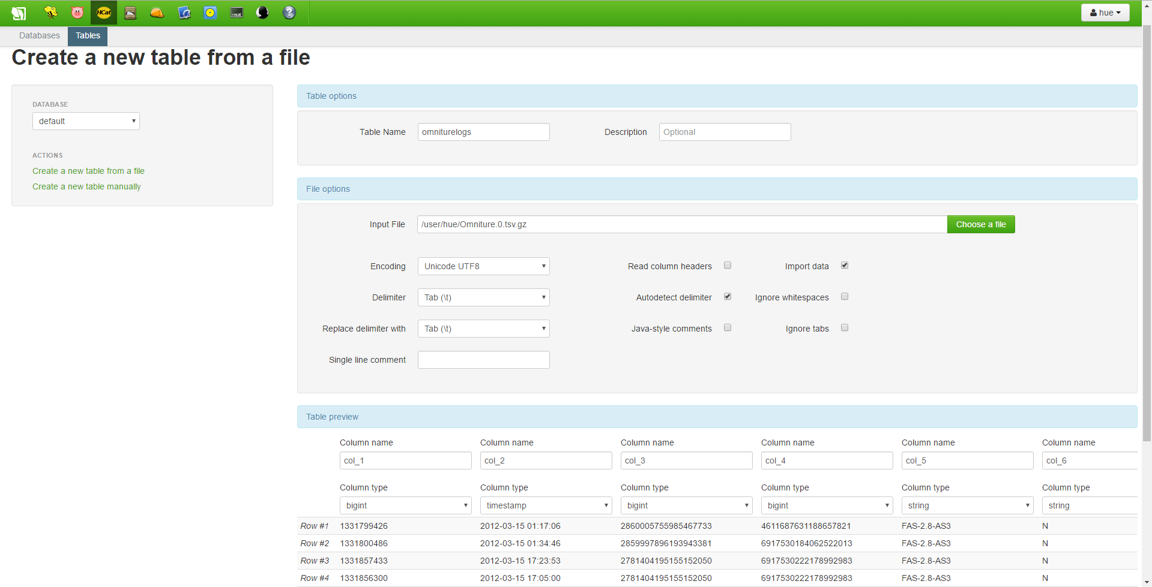
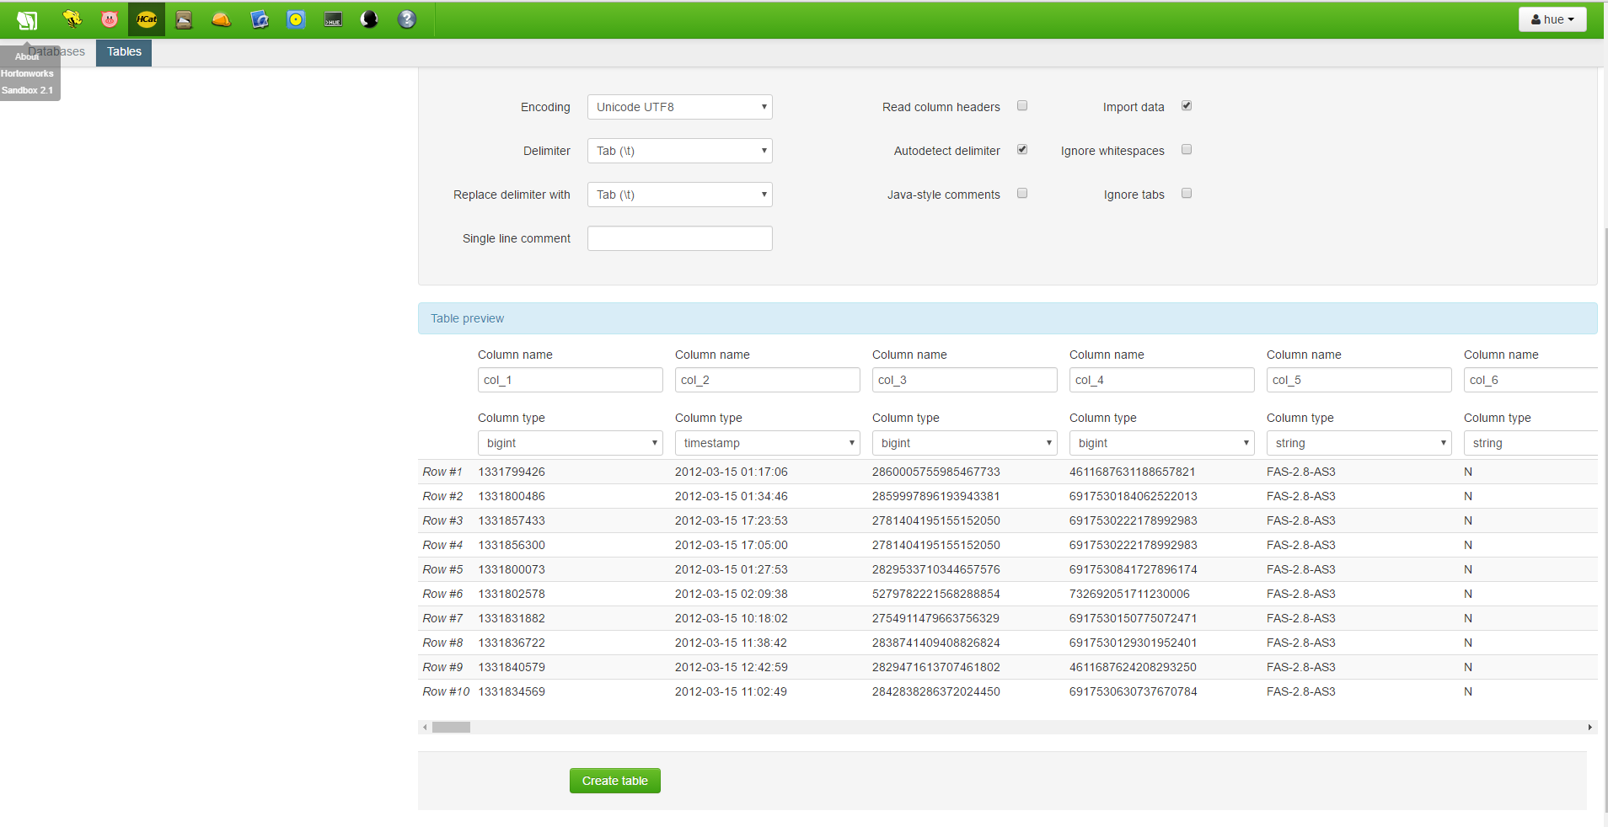
Figure 14: File Options

Slide 27
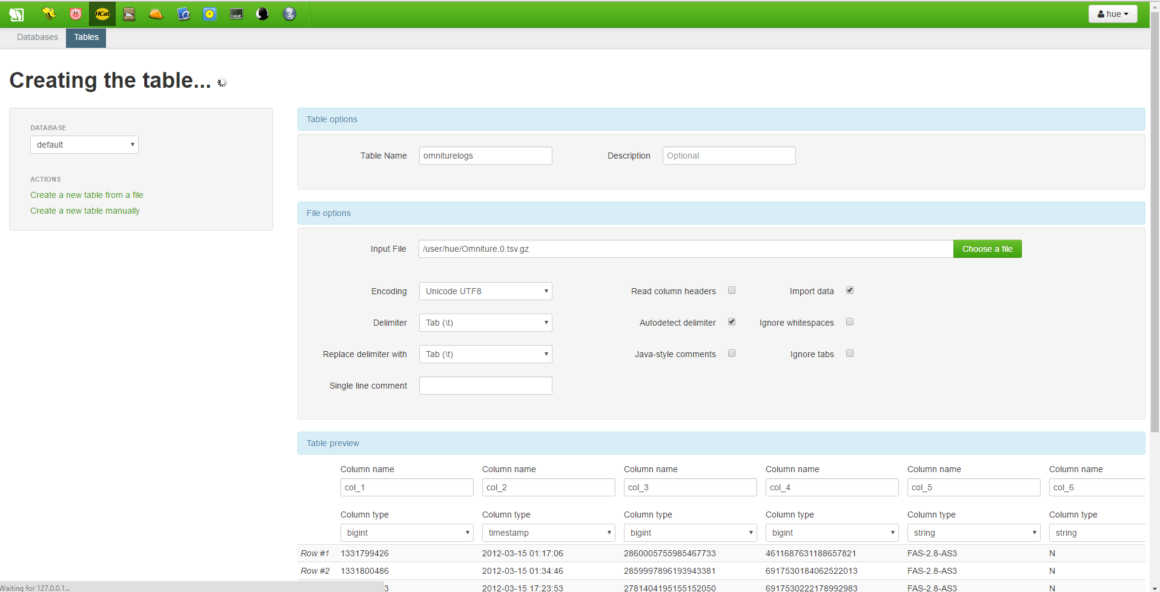
Figure 15: Progress Indicator

Slide 28
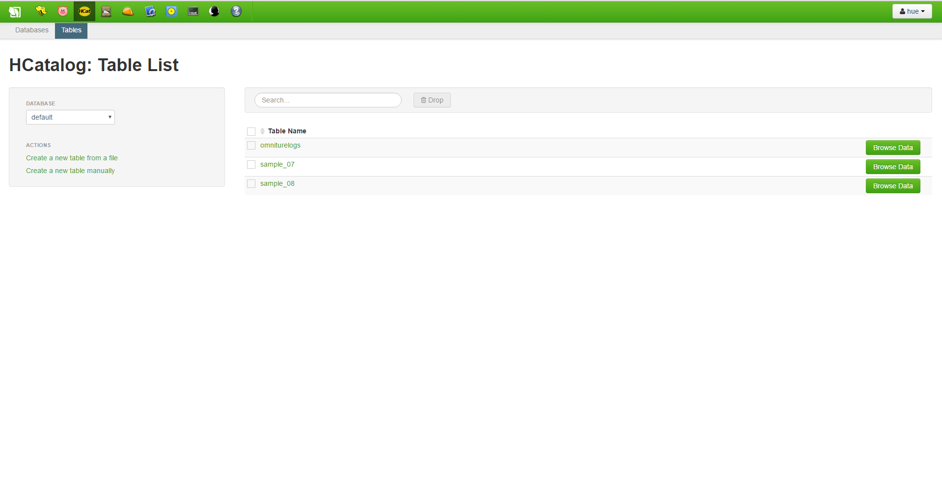
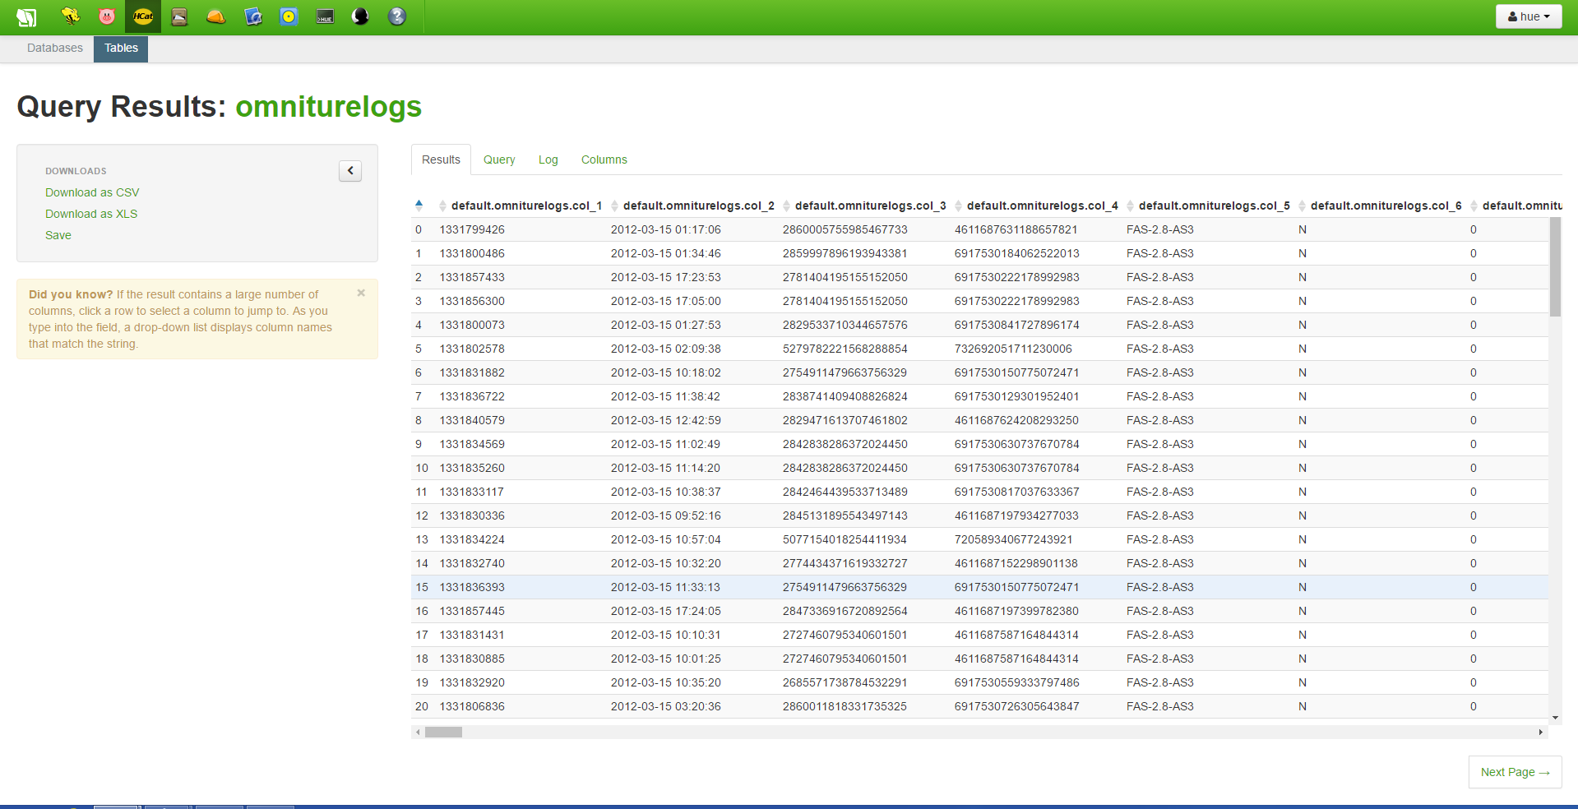
Figure 16: Browse omniturelogs data

Slide 29
Step 9 – Create Products and Users Table
Repeat step 7 to create products and users table.
Click create a new table from file.
Name the tables as products and users.
Upload files products.tsv.gz and users.tsv.gz
Tick the read column headers (opposite when creating omniturelogs table)
Click create table and wait until the progress indicator shows that the table has been created.
Click browse data to see the data in both new tables.
Note:
Ticking read column header enables the first column to be the column name rather than col_1, col_2, col_3

Slide 30
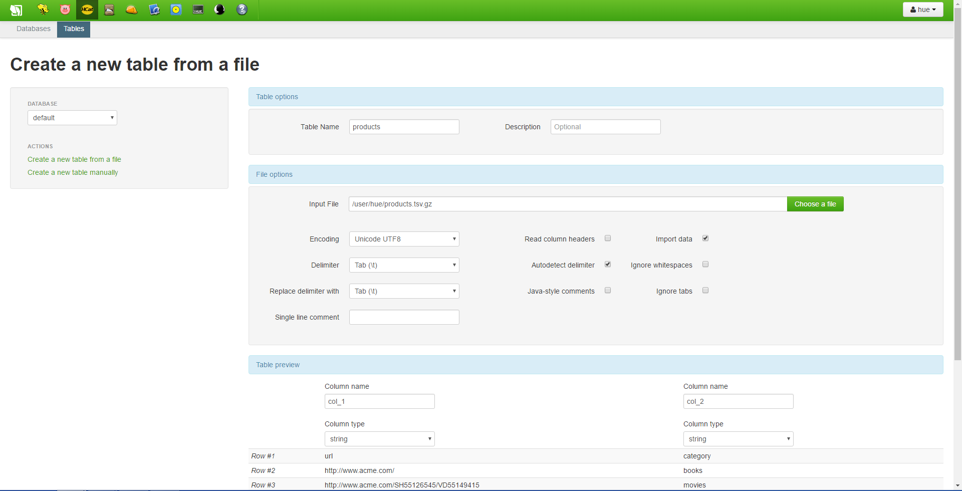
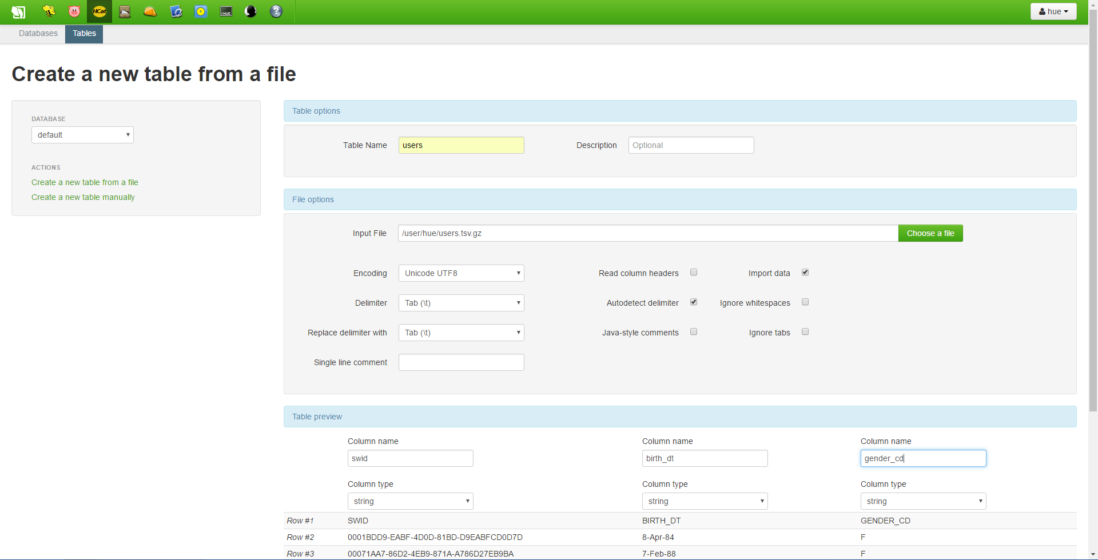
Figure 17: Create users and products Tables

Slide 31
Step 10 – Create omniture table by using Apache Hive
We are going to create another table which contains the subset data of omniturelogs table.
Select Hive menu.
In Query Editor, type command:
CREATE VIEW omniture AS
SELECT
col_2 ts,
col_8 ip,
col_13 url,
col_14 swid,
col_50 city,
col_51 country,
col_53 state from
omniturelogs

Slide 32
Click Save as to save the command.
Name the file as omniture and click Save.
Then, click execute to execute the script.
Once successful, click Hcat menu.
Omniture table is in the list of tables.
Click browse data to see the data.

Slide 33
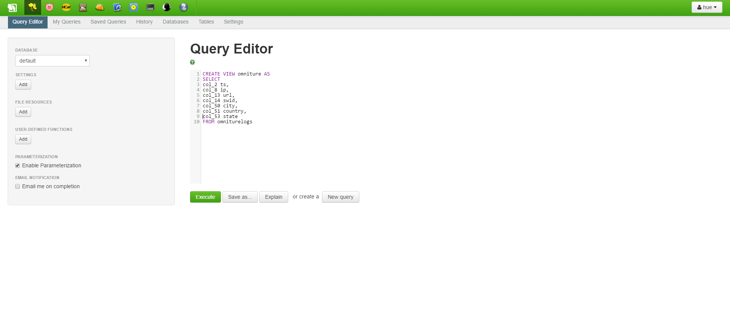
Figure 18: Command in Query Editor

Slide 34
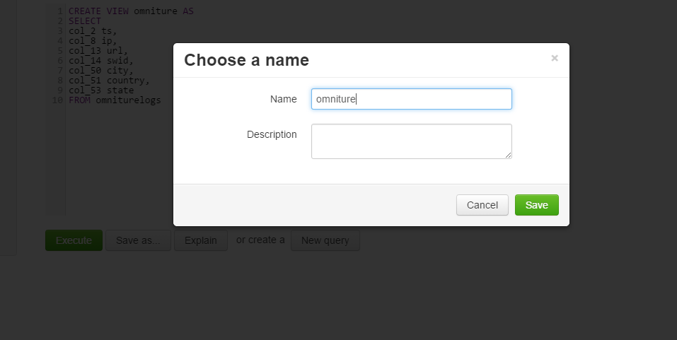
Figure 19: Save and Execute omniture

Slide 35
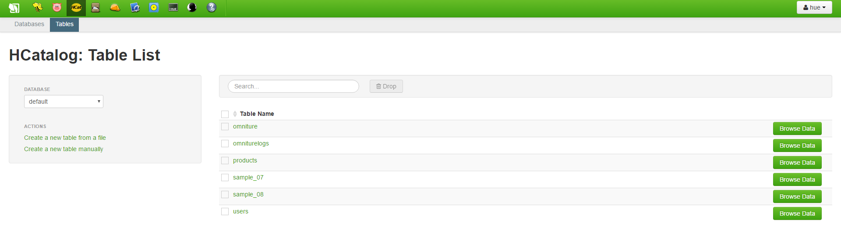
Figure 20: Browse omniture data

Slide 36
Step 11: Combine omniture, products and users by using Apache Hive
By using Apache Hive, we combined the three tables; omniture, products and users to be a master table.
Click Hive menu.
On Query Editor, type the command:
create table webloganalytics as
select to_date(o.ts) logdate, o.url, o.ip, o.city, upper(o.state) state,
o.country, p.category, CAST(datediff( from_unixtime( unix_timestamp() ),
from_unixtime( unix_timestamp(u.birth_dt, 'dd-MMM-yy'))) / 365 AS INT) age, u.gender_cd
from omniture o
inner join products p
on o.url = p.url
left outer join users u
on o.swid = concat('{', u.swid , '}')

Slide 37
Click Save as to save the script.
Name the file as webloganalytics and click Save.
Then, click execute to execute the script.
Once successful, click Hcat menu.
Webloganalytics table is in the list of tables.
Click browse data to see the data.

Slide 38
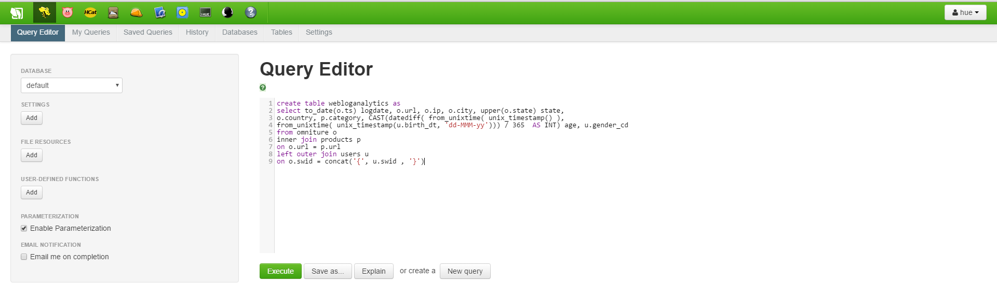
Figure 21: Command webloganalytics in Query Editor

Slide 39
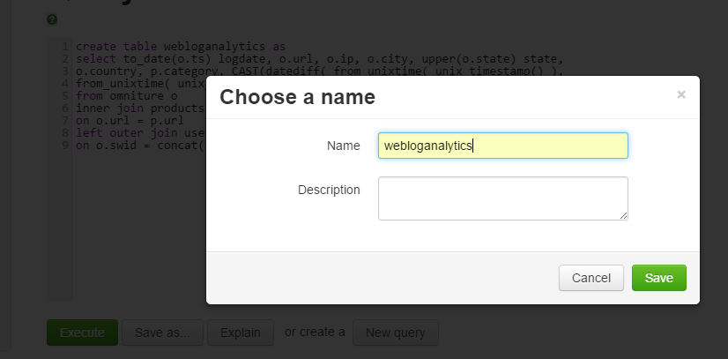
Figure 22: Save and Execute webloganalytics

Slide 40
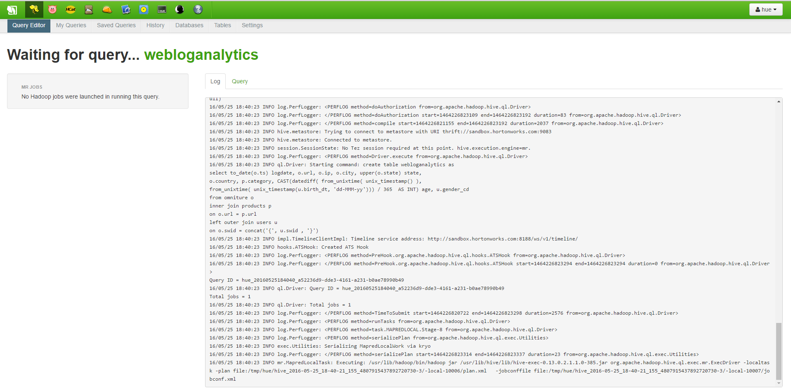
Figure 23: Progress Indicator

Slide 41
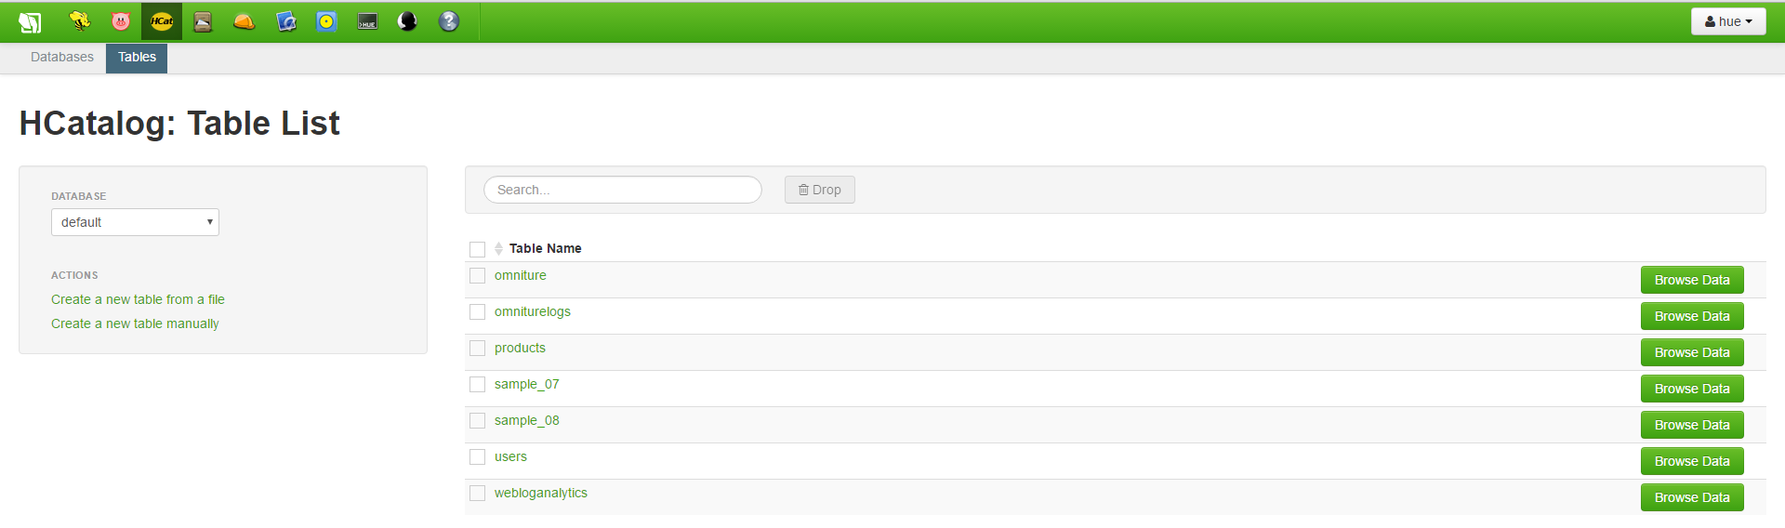
Figure 24: List of Tables in Hcat including omniture and webloganalytics

Slide 42
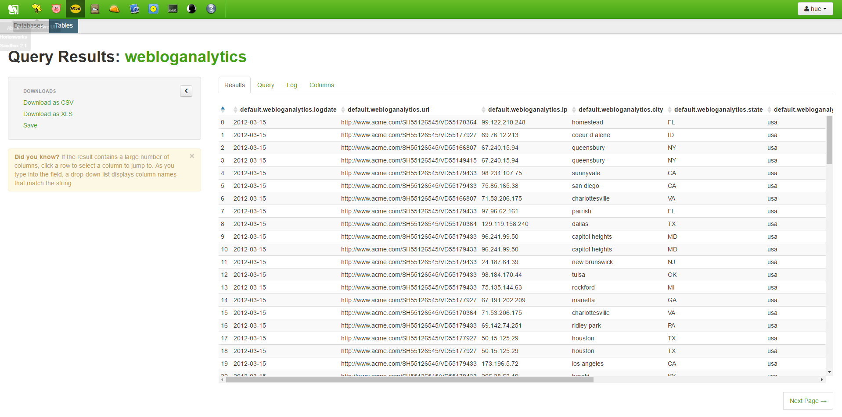
Figure 25: List of Webloganalytics Data

Slide 43
Step 12: Give Permission to Use Data from Hortonworks
Press Alt and F5 key on Oracle VM Virtual Box and login
Username: root
Password: hadoop
Type hive and wait until the word hive appear on the screen
Type another command: Grant SELECT on table webloganlytics to user hue;
Wait until the word time taken appears.
Note:
The second command is used to give permission for the computer to use the data from Sandbox

Slide 44
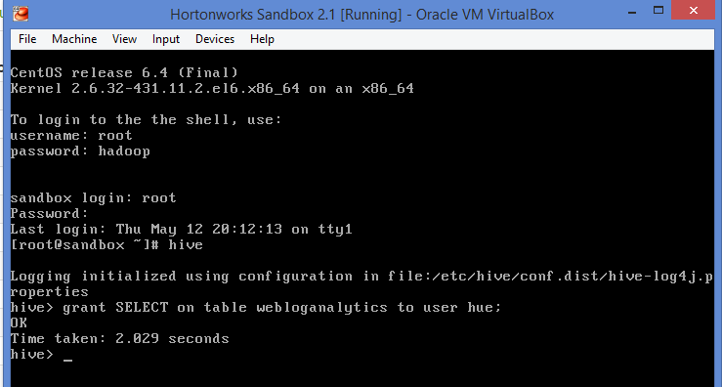
Figure 26: Grant permission to use Hortonwork Data

Slide 45
Step 13: Import Data to Microsoft Excel
Open Microsoft Excel Professional 2013.
Select Data → From Other Sources → From Microsoft Query
Select Sample Hortonworks Hive DSN from Choose Data Source and click OK.
In Query Wizard – Choose Column, scroll and select webloganalytics.
Select the larger than symbol (>) and click Next.
Click Next for both Query Wizard – Filter Data and Sort Order.

Slide 46
Click Finish in Query Wizard – Finish.
Click OK for Import Data.
The progress indicator indicates that data is still being loaded into Excel.
Wait until the data is displayed.
Since the data is big, ignore the Not Responding issue and just wait until all the data are being displayed on the Excel.

Slide 47
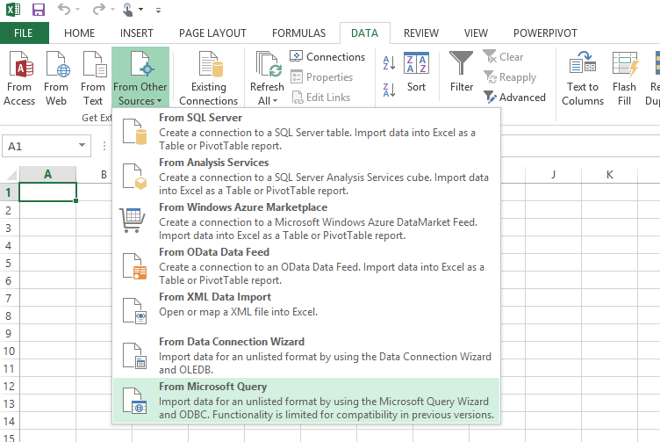
Figure 27: Import Data From Microsoft Query

Slide 48
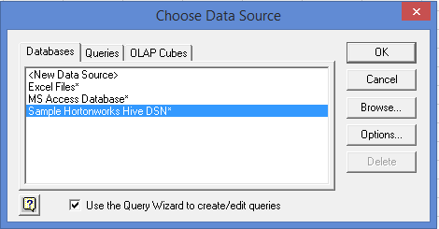
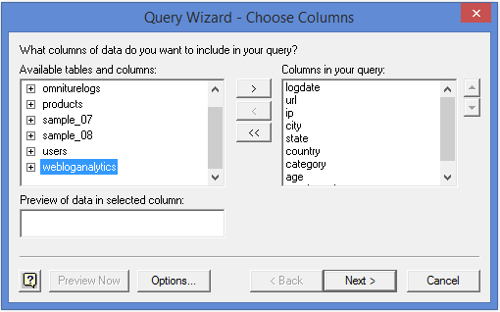
Figure 28: Data Source and Data Column

Slide 49
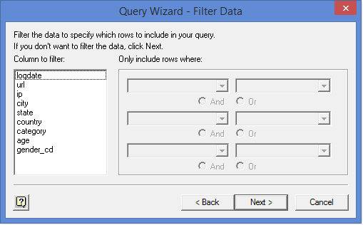
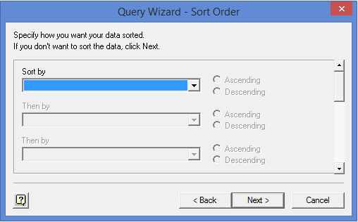
Figure 29: Filter Data and Sort Data

Slide 50
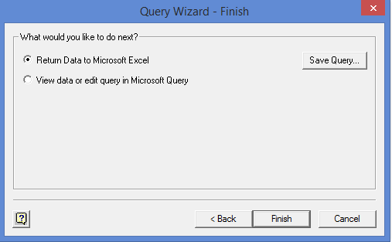
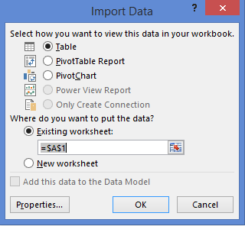
Figure 30: Finish Import

Slide 51
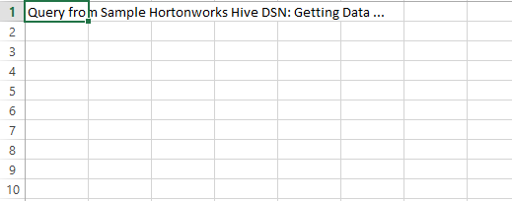
Figure 31: Loading Webloganalytics data

Slide 52
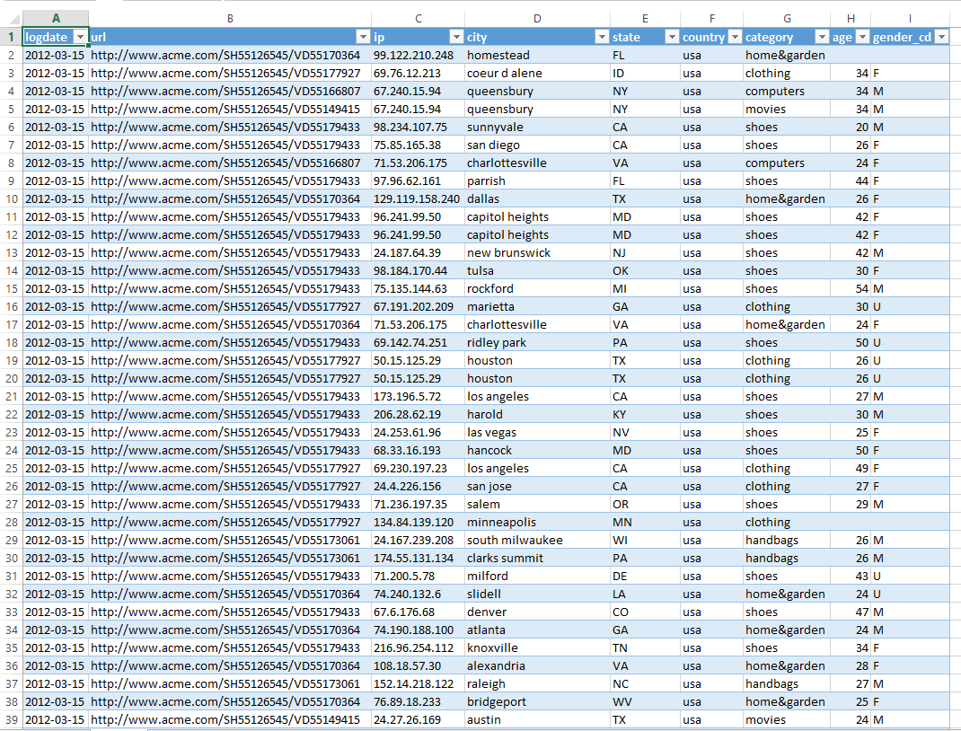
Figure 32: Webloganalytics data

Slide 53
Step 14: Analyze data using Power View
We use Power View function in Excel to analyze the big data.
Open Power View to start analyzing data. Click Insert then Power View.
The Power View is opened as Figure 32.
1 – Content area
2 – Filter area
3 – Power View Fields area
Note:
Power view can be open as many as you want. Go to Insert → Power View

Slide 54
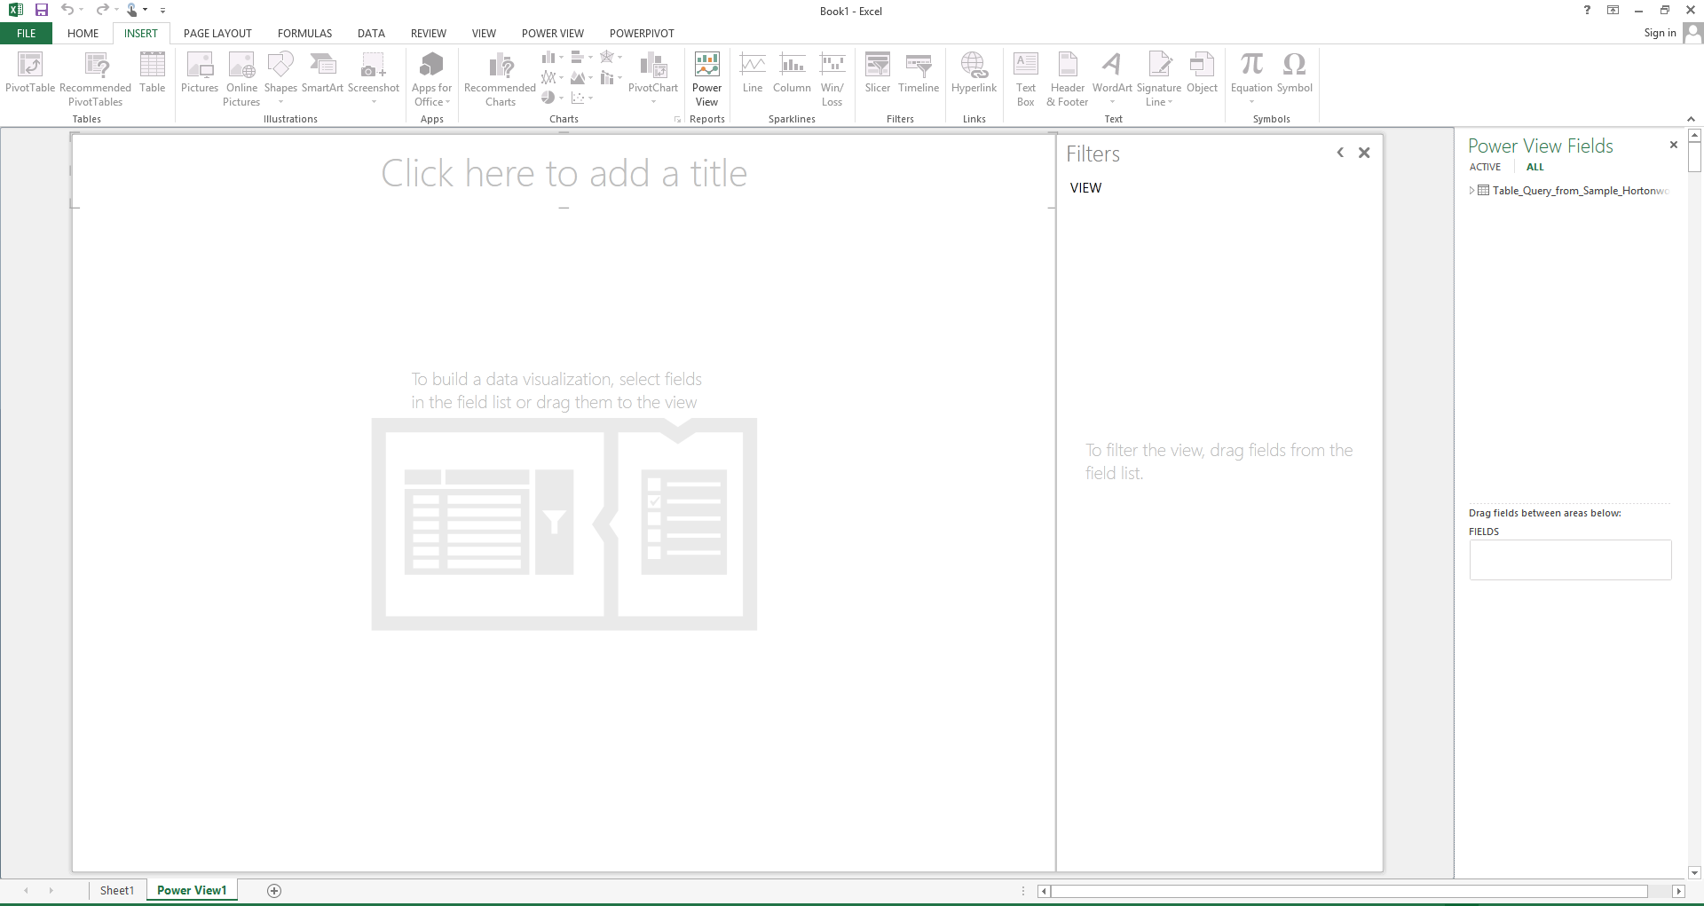
Figure 33: Open Power View

Slide 55
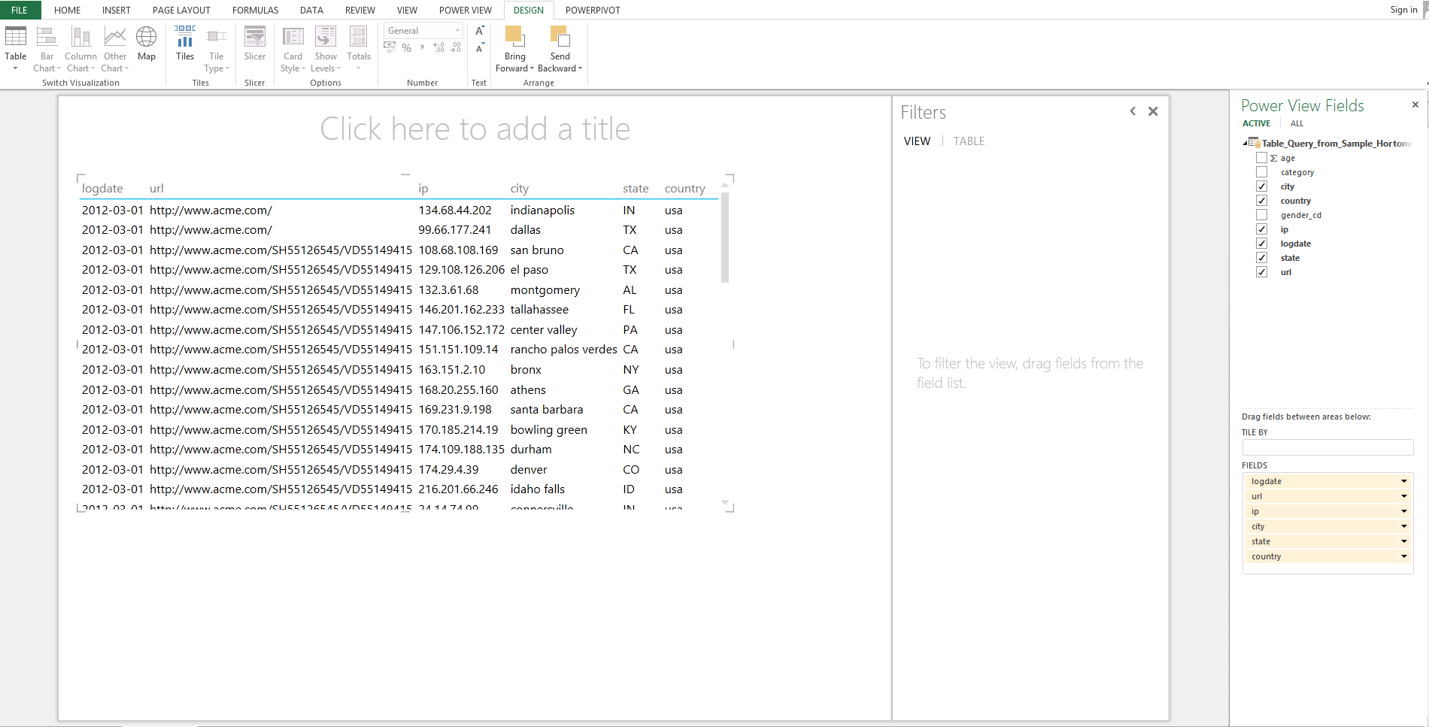
2
3
1
Figure 34: Power View with data

Slide 56
Example 1: Maps
Use the same Power View as Figure 32.
Firstly, In Power View Fields, only country checkbox is left selected.
Country field then is dragged into the fields in the bottom.
In the content area, list of country is listed as per selected in Power View Fields.

Slide 57
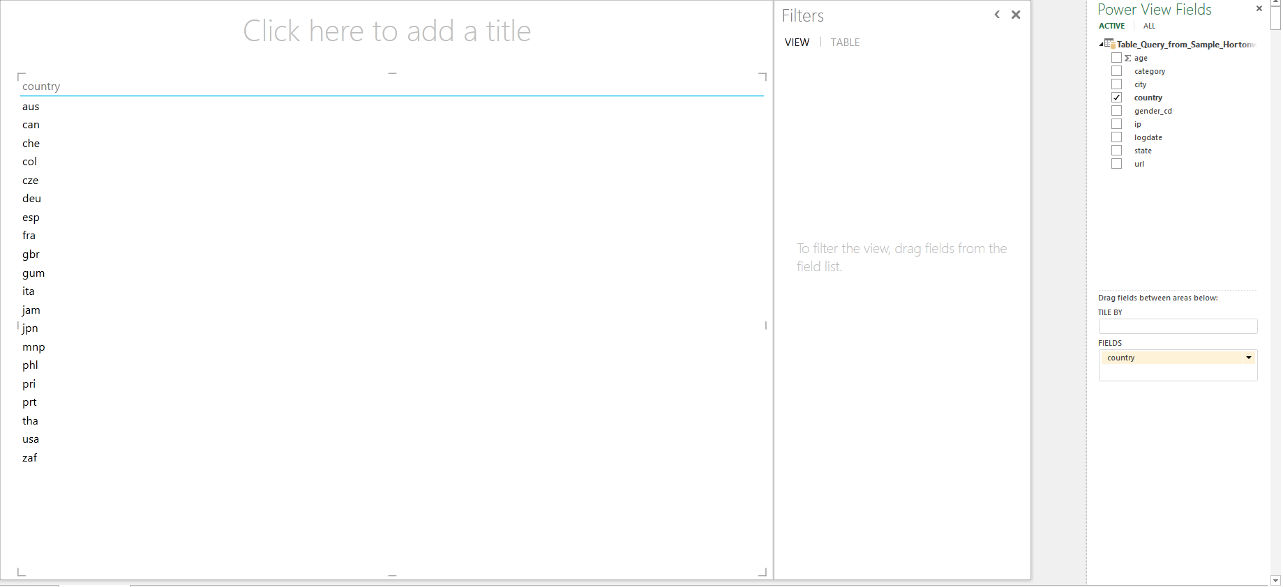
Figure 35: Select Country Checkbox

Slide 58
Click Design and select Map.
A map consists of the country available in the data appears.
To display a more accurate result, click Enable Content to give permission to Bing to use the data.
Once we enable the content, we can see blue circle on the map which shows the location of country (Figure 37).

Slide 59
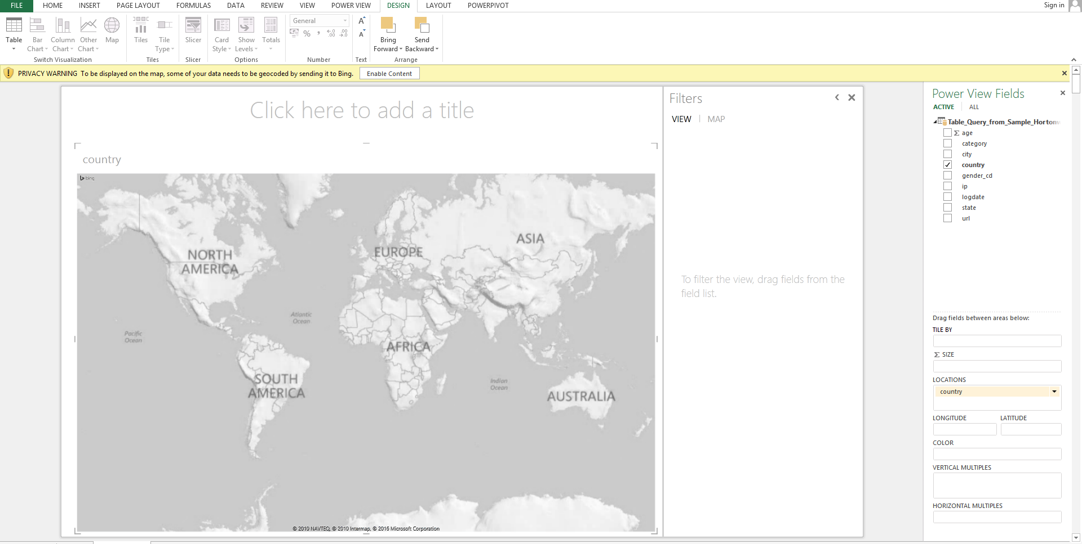
Figure 36: Map

Slide 60
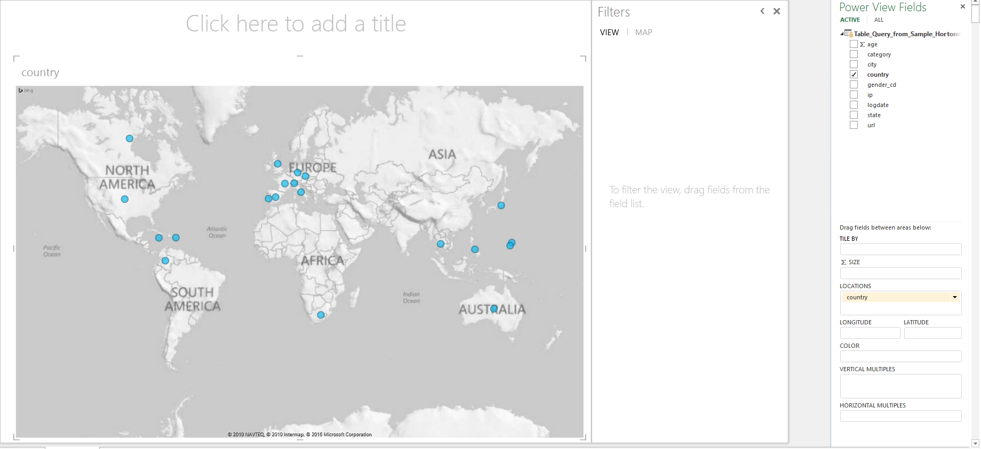
Figure 37: Data on Map

Slide 61
Next, we change the content of the map.
On the same Power View, drag the ip field into size (box below to display information on country based on the traced IP number (Figure 38).
Drag Country field into filter area and tick the USA checkbox.
Only one blue circle left in the content area (Figure 39).
Drag state field to Location below and remove country field by using the dropdown option: Remove field.
Hover the mouse to the blue circle to see the number of IP address over the states in USA country (Figure 40).

Slide 62
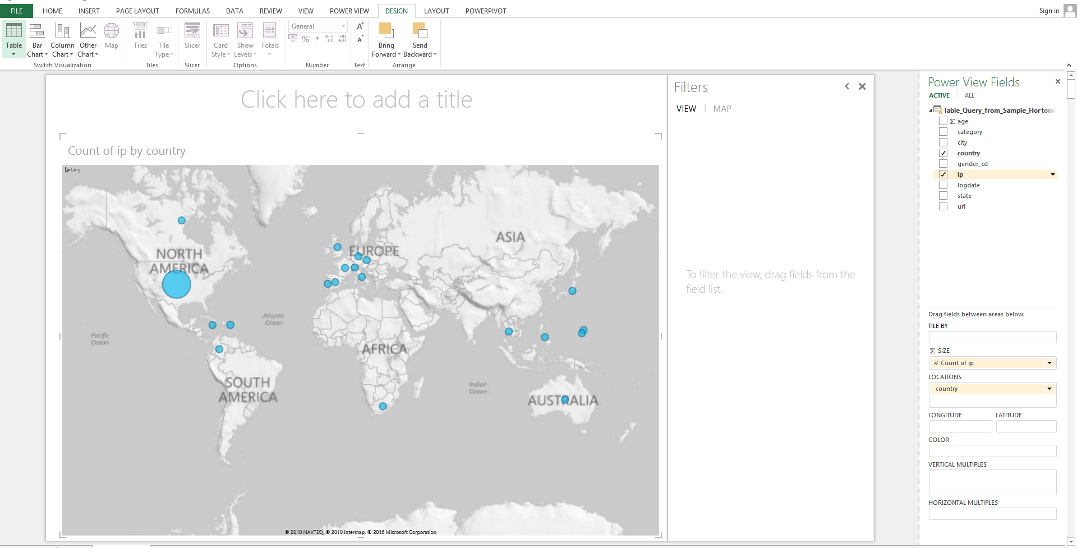
Figure 38: Add IP address on Map

Slide 63
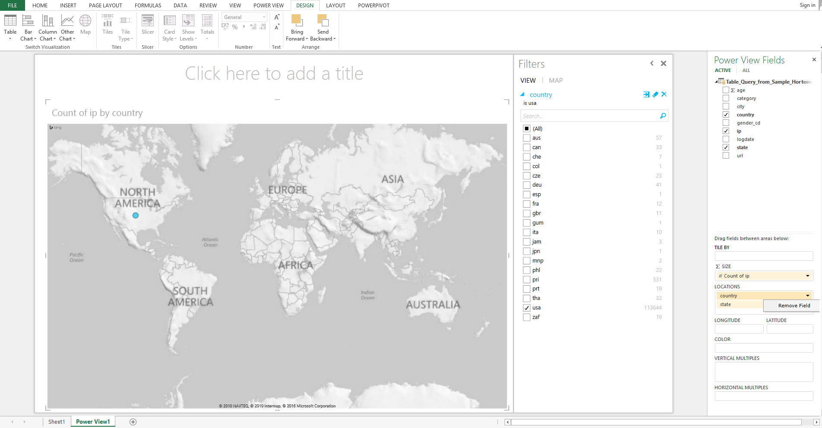

Slide 64
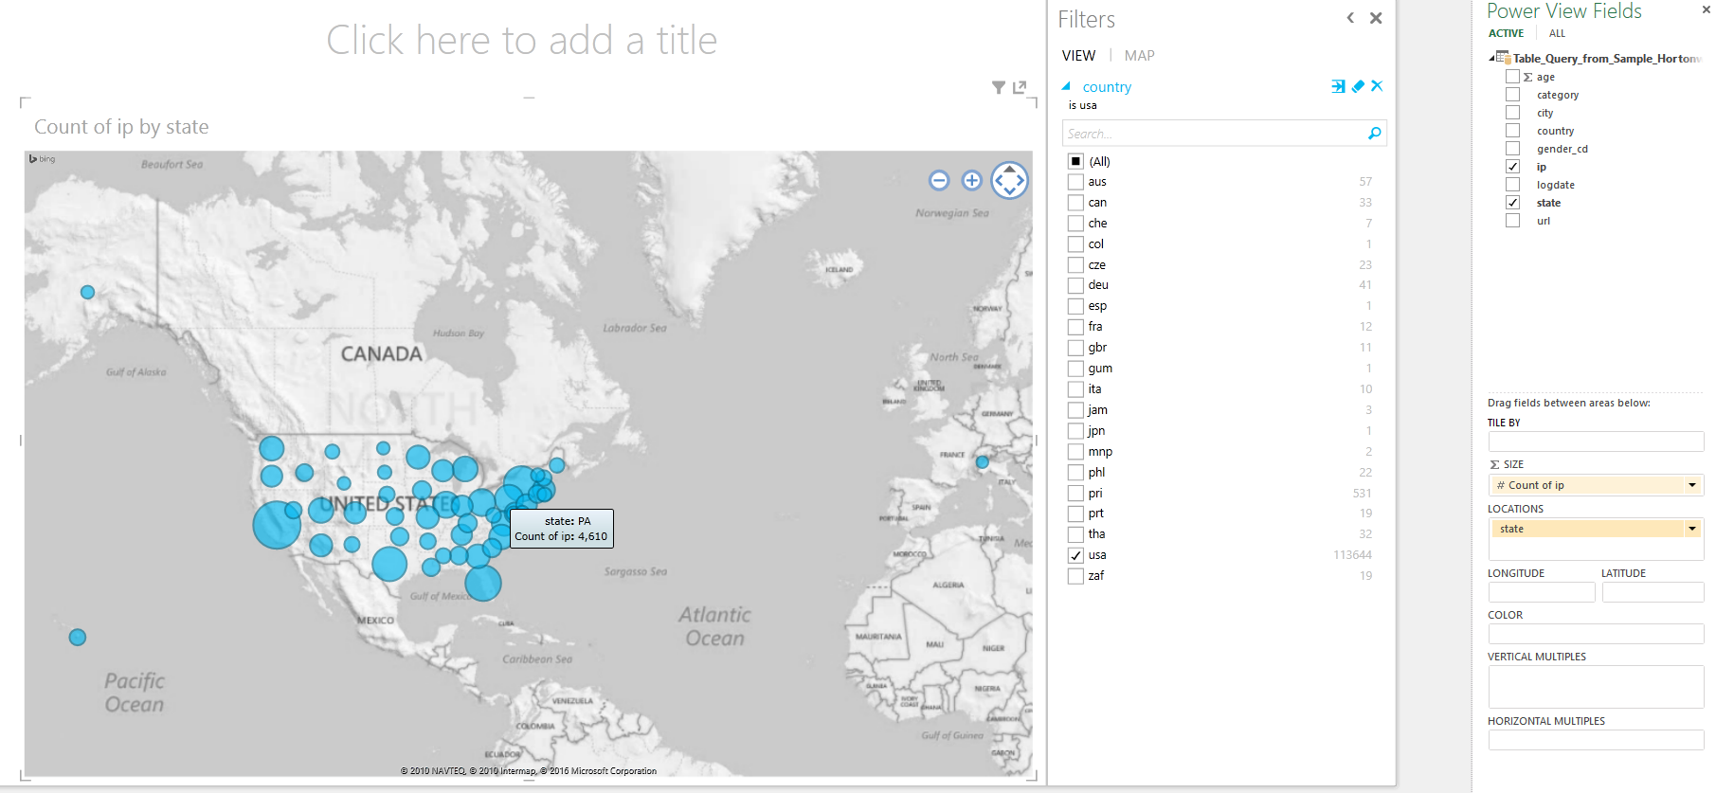
Figure 40: Count of IP address based on states in USA

Slide 65
Tick category field on Power View Fields.
Drag category field into the Color field below.
In content area, the blue circles (Figure 40) now have now turn into colorful circles (like pie chart).
The pie charts show the category that the IP address is originated from each state in USA country (Figure 41).

Slide 66
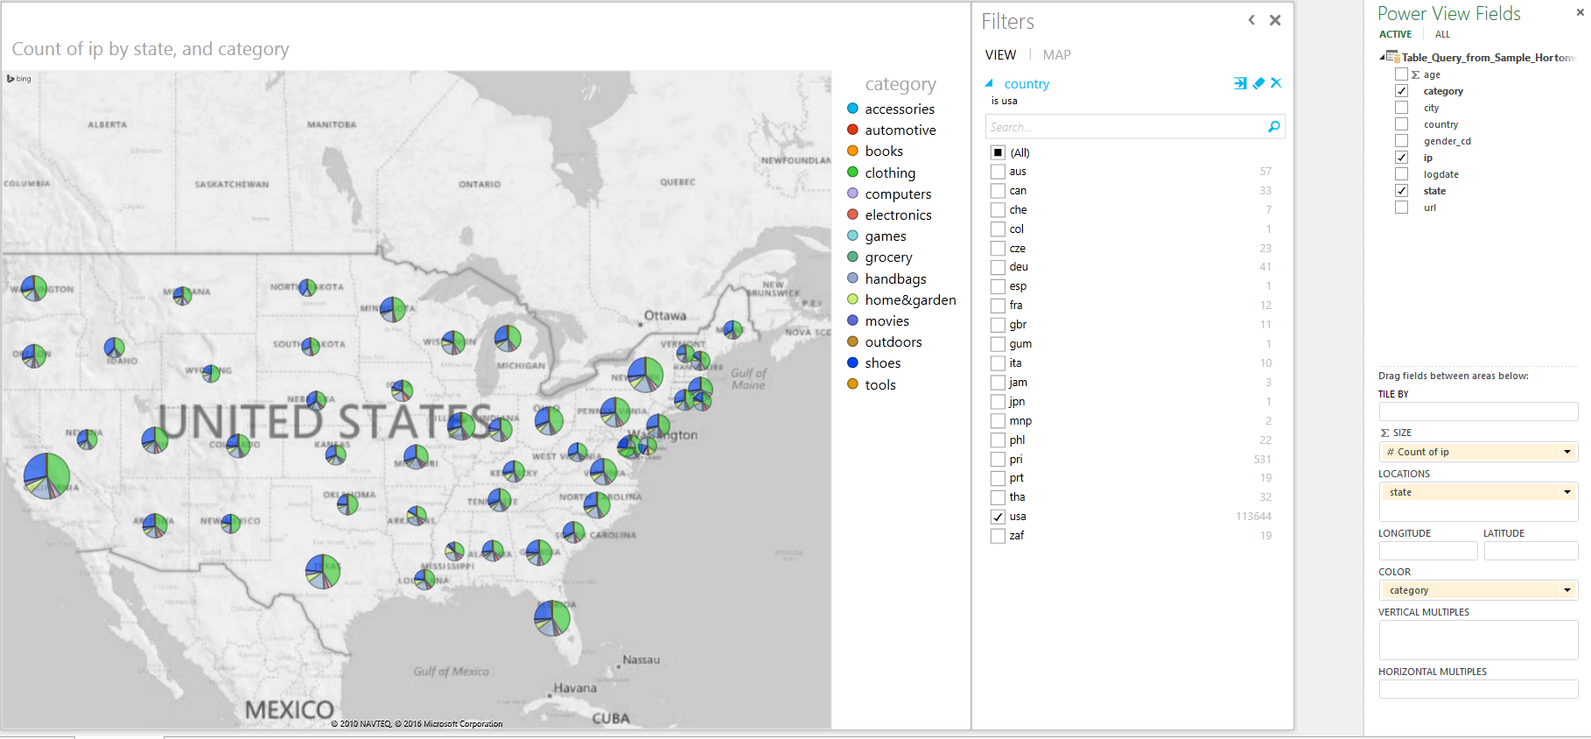
Figure 41: Category in each state in USA country

Slide 67
Example 2: Clustered Chart
Open another Open View.
Tick age field ip field.
Drag category and gender_cd fields into Filter area.
Tick clothing for category and male (M) for gender_cd.
In content area, the data on consumers Male that visited website and find the clothing category (Figure 42).
On the Design menu, click Column chart and chose Clustered column.
Figure 43 shows the number of Male consumers based on their ages that visited clothing related website.

Slide 68
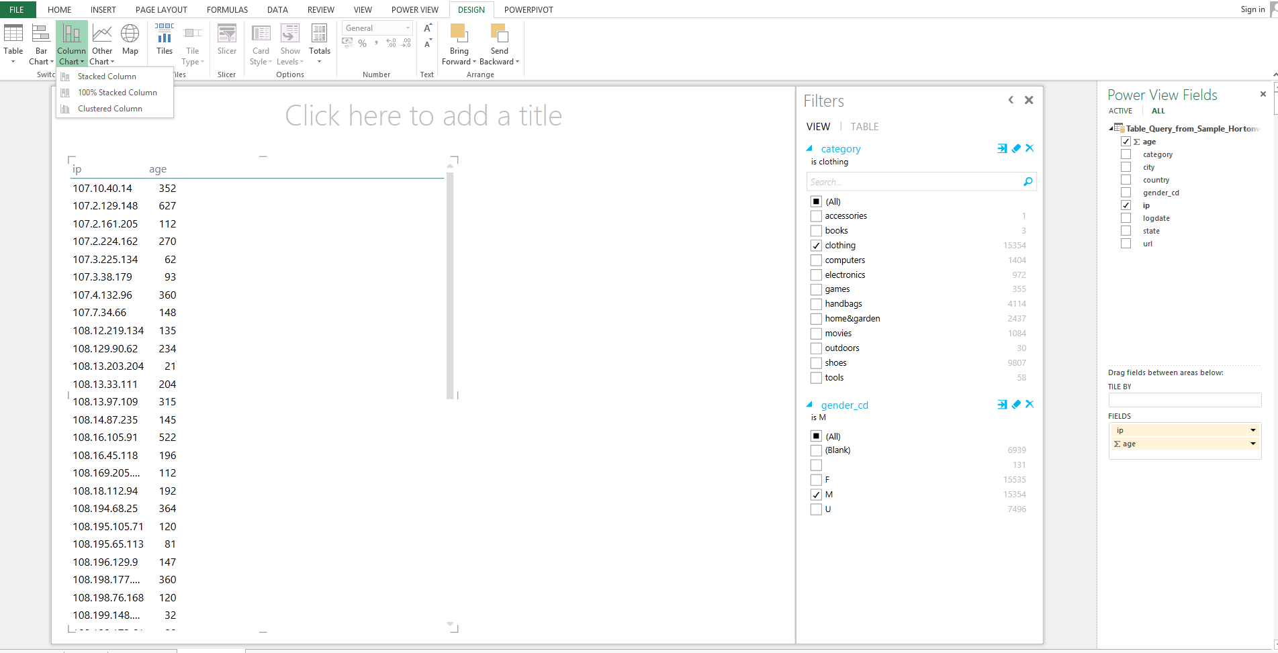
Figure 42: Data on consumers Male with clothing category

Slide 69
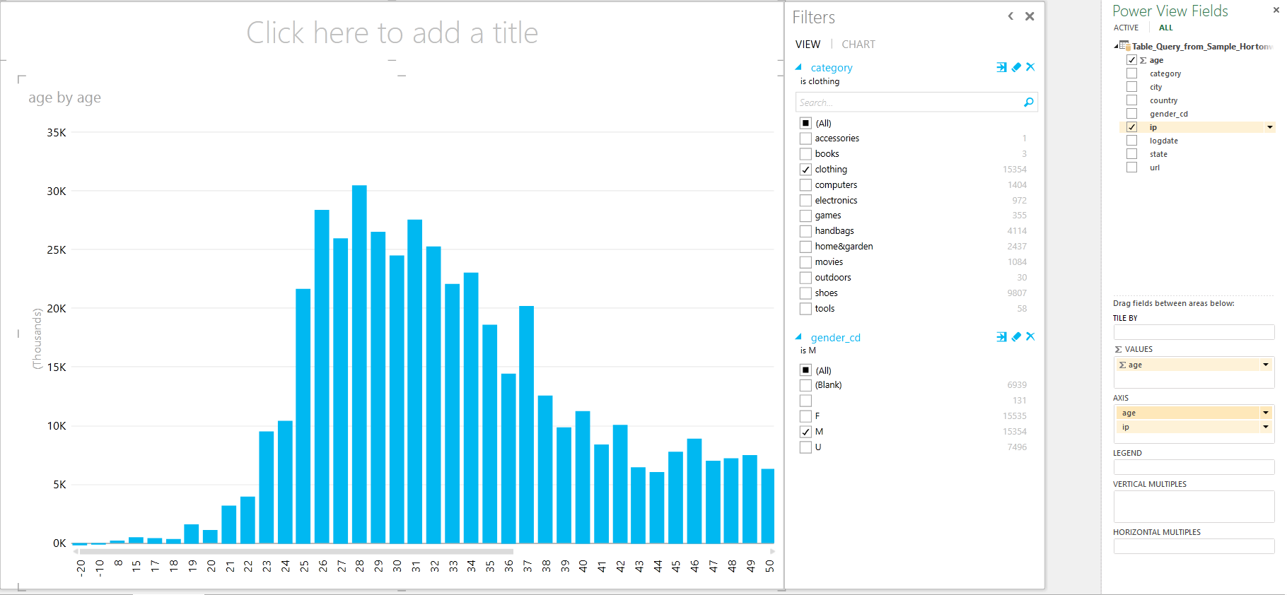
Figure 43: Chart on male consumers based on age and category clothing

Slide 70
Example 3: Pie Chart
Tick logdate in Power View Fields and click the down-arrow of logdate and choose Add to Table as Count.
Drag logdate to Filter area and filter for date 2012-03-01 until 2013-03-05.
Go to Design. Choose Other chart and select pie chart.
Drag logdate into Color field.
Drag category to filter area and filter for clothing and handbags.
Each color in the pie chart represents the total number of consumers who visited website related to clothing and handbags.

Slide 71


Slide 72


Slide 73
Example 4: Try on your own
You can try various combination of data in webloganalytics table to analyze the data.
You can find the category that popular with the range group of age or the number of male and female consumers for each category.
You can analyze the category that other country’s consumers have visited.
You can also analyze the most visited url by male and female consumers.

Slide 74
Discussion

Slide 75
Data Analysis
Total number of data: 114,471
High data quality: 71,198
Poor data quality:
Age | Results
Negative age (-ve) | 63
Null | 26,795
Negative age (- ve) + Null | 26,858
Gender_cd | Result
Null | 26,341
Unknown (U) | 16,660
Blank | 225
Null + Unknown (U) + Blank | 43,226

Slide 76
Errors (Poor Data Quality)
The age and gender_cd data in the tutorial violate data quality rules.
More specifically both data violate valid value constraint rules and optionality constraints under Attributes Domain Constraint Rule.
In order to provide accurate result, it is important to analyze correct information.
Errors in gender_cd and age give inaccurate analysis if they are not excluded in the analysis.

Slide 77
Valid Value Constraint | Explanation
Age such as -10, -15, -18, -19 and -20 are invalid values. | There is no negative number for age. Age is supposed to be only in positive numbers. The minimum number based on year in age is 1 year old and the age value increased every year. So, data with negative age violated valid value constraint.
Gender_cd such as unknown (U) | Basically, gender is categorized only as male (M) and Female (F). Unknown gender could mean either male or female. So, the data can not be counted for analysis. The data of gender should only be definite because there are only male and female genders.

Slide 78
Optionality Constraint | Explanation
Age such as null value | This data violated Optionality Constraint. The age is not supposed to be null. The age should have value in positive numbers such as 20, 30 and 50. Null value means that the age of the user is unknown. So, the data of the user can not be counted. Furthermore, age is a required field which needs value in the field.
Gender_cd such as null and blank gender | Gender is a required field which needs data in the field. So, when gender is null or blank, the data is invalid because there has to be only two values in the gender_cd field which either male or female. So, null is not supposed to be the value in gender_cd field.

